Slide 1

Dorsiflexion Range Of Motion Analyzer
Sheli Zisman and Ron Kroitoro
Supervisors: Dr.Unkelos-Shpigel Naomi & Dr. Ravid Einat
Project Code : 26-1-D-4

Slide 2



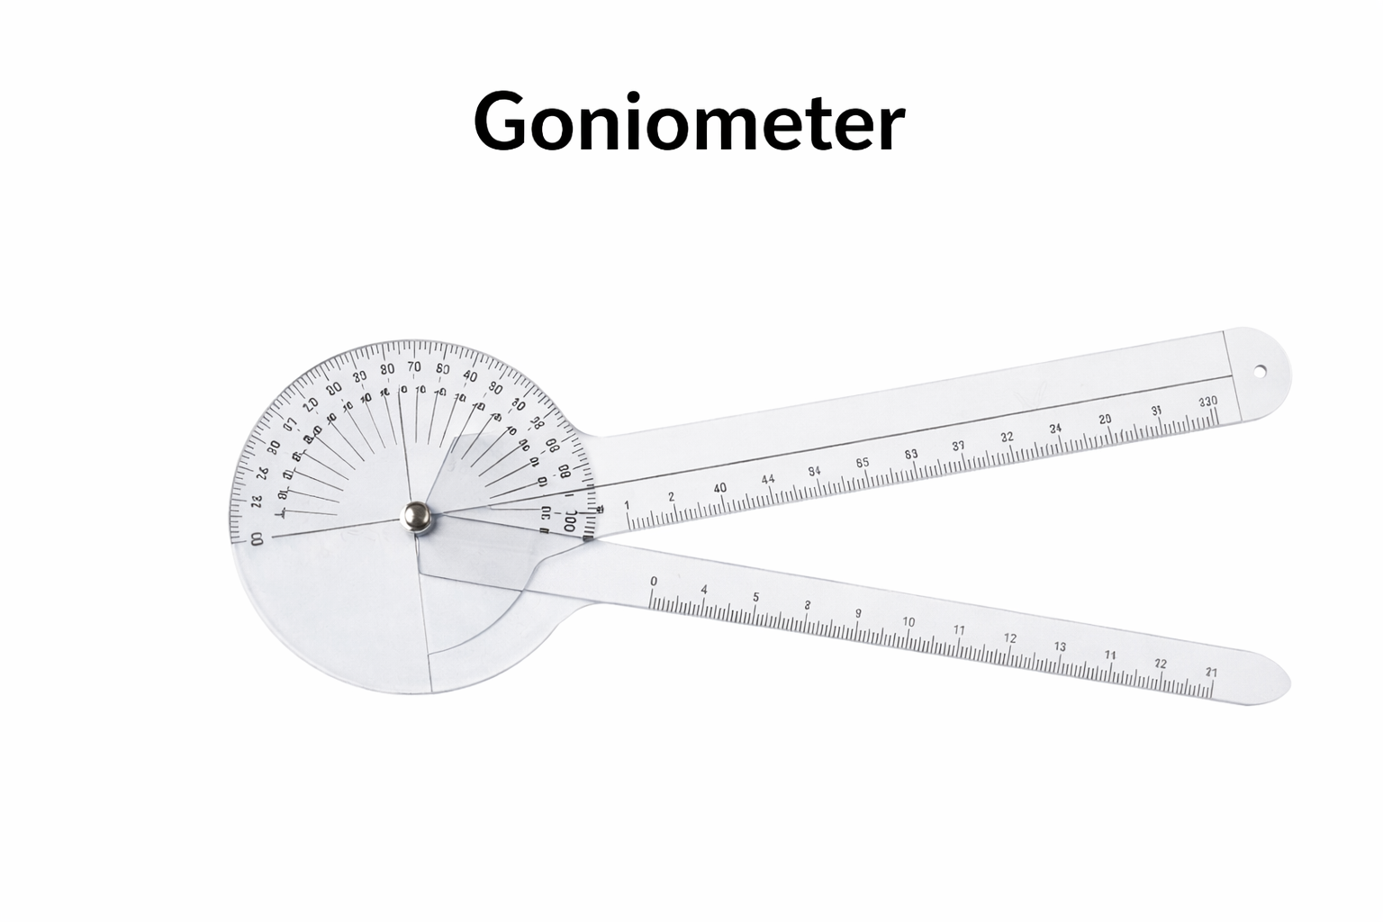
The need for our system
The Gap: Traditional dorsiflexion assessment suffers from high inter-rater variability and inconsistent results.
Subjectivity: Manual identification of anatomical keypoints introduces human error.
Dependency: Measurements rely on in-clinic evaluations and in expert availability.

Slide 3
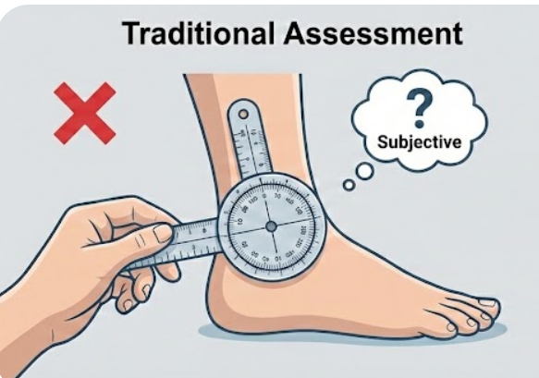
The consequences of manual measurement
Liability Risk: Lack of objective data increases malpractice exposure.
Reliability Gap: Significant inter-rater variability and human error.
Landmark Challenges: Inconsistent identification due to swelling or lighting.
No "Visual Proof": Numerical notes lack verifiable evidence.
Clinical Stakes: Inaccuracies impact surgery and rehabilitation decisions.
1. S. E. Munteanu and C. J. Barton,“Lower limb biomechanics during walking in individuals with restricted ankle dorsiflexion: A systematic review,”Journal of Foot and Ankle Research, vol. 4, Art. 17, 2011
2. N. Collins, P. Teys, and B. Vicenzino,“Reliability of ankle dorsiflexion measurement using different clinical techniques: A systematic review,”Journal of Foot and Ankle Research, vol. 7, Art. 21, 2014
3. C. C. Norkin and D. J. White,Measurement of Joint Motion: A Guide to Goniometry, 5th ed.Philadelphia, PA, USA: F. A. Davis Company, 2016

Slide 4
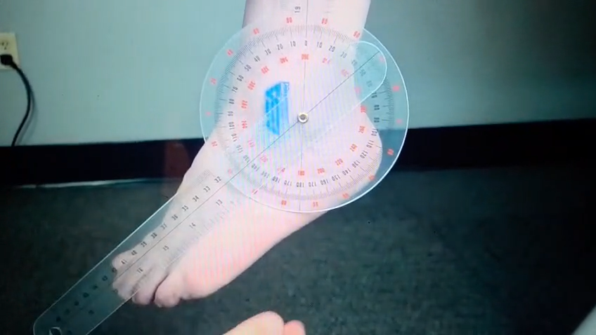
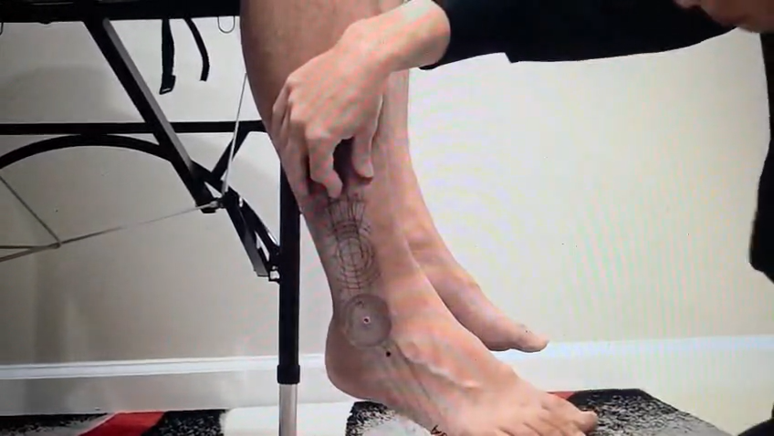
Lack of Standardization in Manual Goniometric Measurement

Slide 5
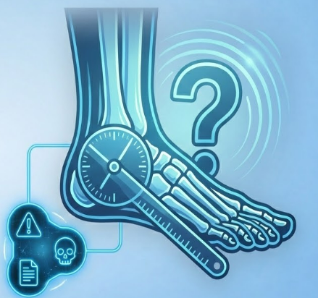
The Problem
.
How can ankle dorsiflexion ROM be measured in an objective and standardized manner to reduce subjectivity and improve clinical consistency?

Slide 6


Interviews
"To be honest, we’re so busy that we often just estimate the angle using visual estimation. Even when we do use the goniometer, if you move it just a tiny bit, the result changes completely. It’s just not consistent."
Senior Orthopedic Surgeon (Head of Dept., Hospital X)
“During dorsiflexion measurement, it is very difficult to accurately identify the correct measurement point, especially when the foot is swollen. Ankle anatomy varies between patients, and the measurement relies heavily on visual estimation and manual goniometry. In practice, this often results in inconsistent measurements and a form of angle ‘guessing’.”
Orthopedic Resident (Hospital X).
.

Slide 7
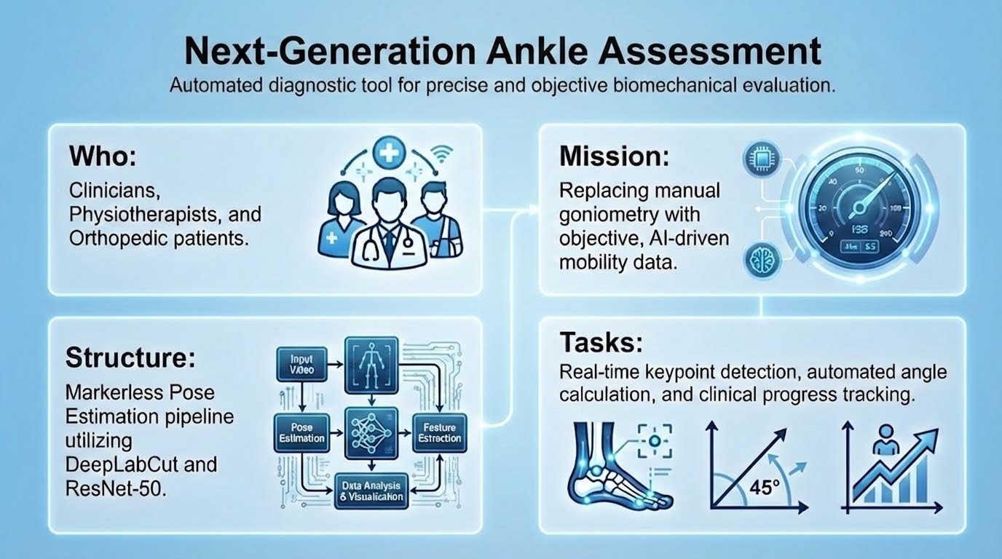

Slide 8

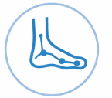


Our Solution
.
Two-Image Analysis: ROM is calculated from two images: neutral position and maximum dorsiflexion.
Markerless Detection: DeepLabCut automatically identifies ankle landmarks without markers or manual calibration.
Objective Measurement: A standardized, repeatable ROM value replaces subjective visual estimation.
Fast Clinical Workflow: Capture two images and receive an immediate digital result.

Slide 9
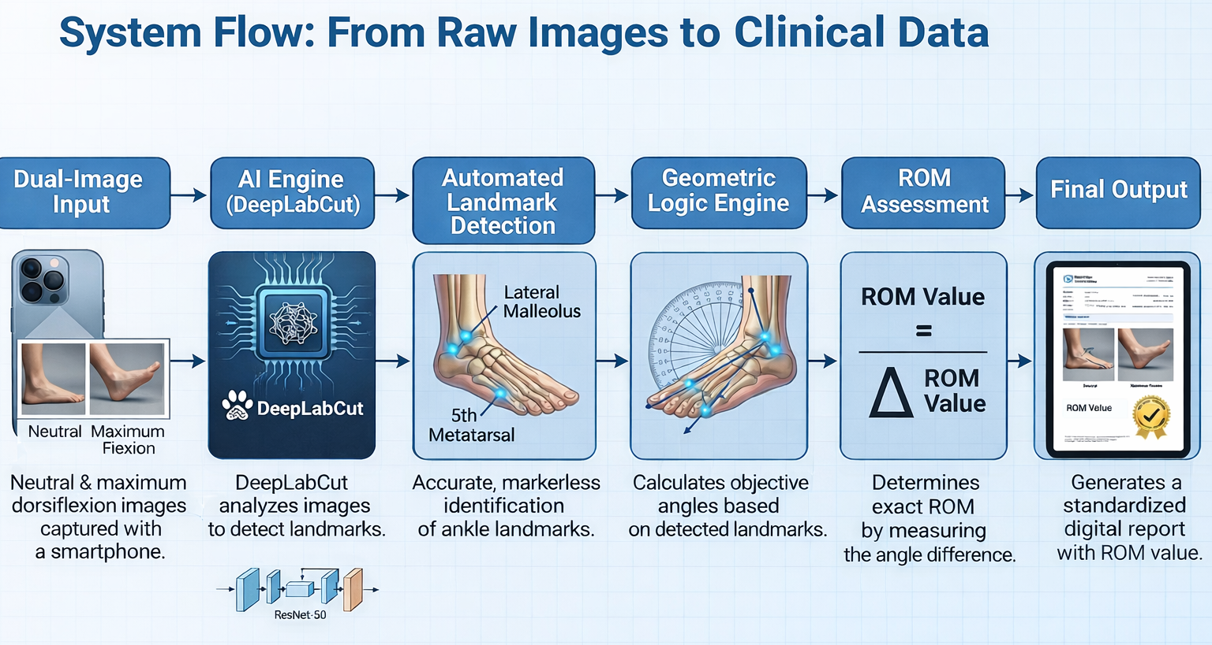

Slide 10
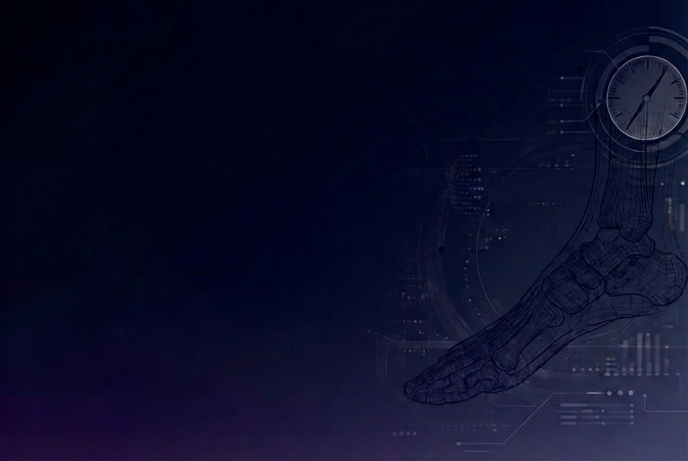
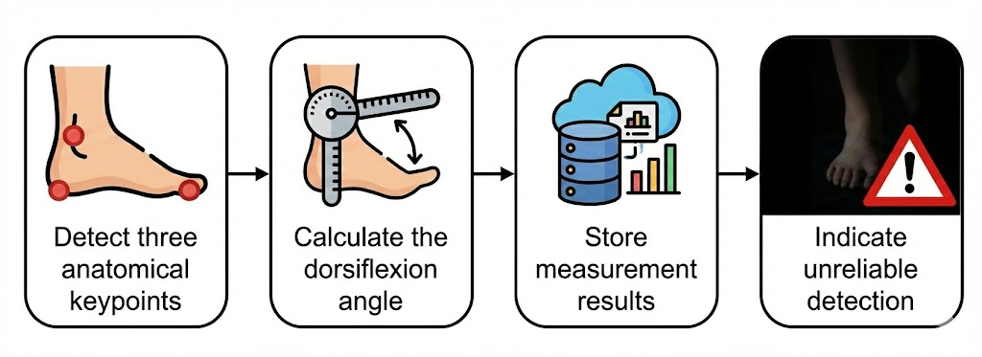
Main functional requirements
Detect three anatomical keypoints from a single image.
Automatically calculate the dorsiflexion angle.
Store measurement results for review and comparison.
Indicate unreliable detection (e.g., poor lighting or occlusion).
.

Slide 11
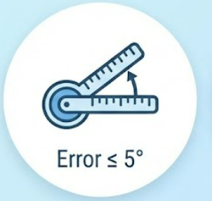

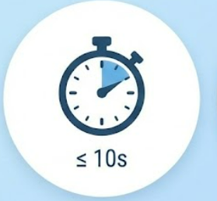
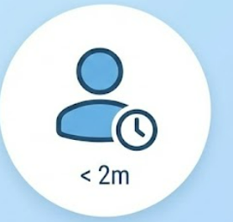
Main non - functional requirements
.
Accuracy: Measurement error of up to 5° compared to a clinical goniometer.
Reliability: ≥ 95% successful keypoint detection.
Performance: ≤ 10 seconds per image.
Usability: Full measurement in < 2 minutes for new users.

Slide 12
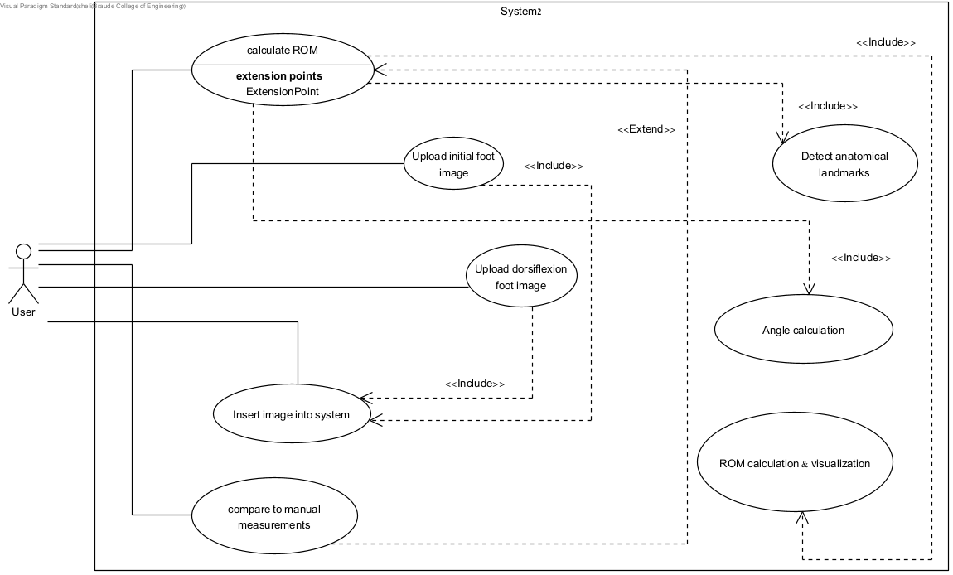
Use - Case diagram
.

Slide 13
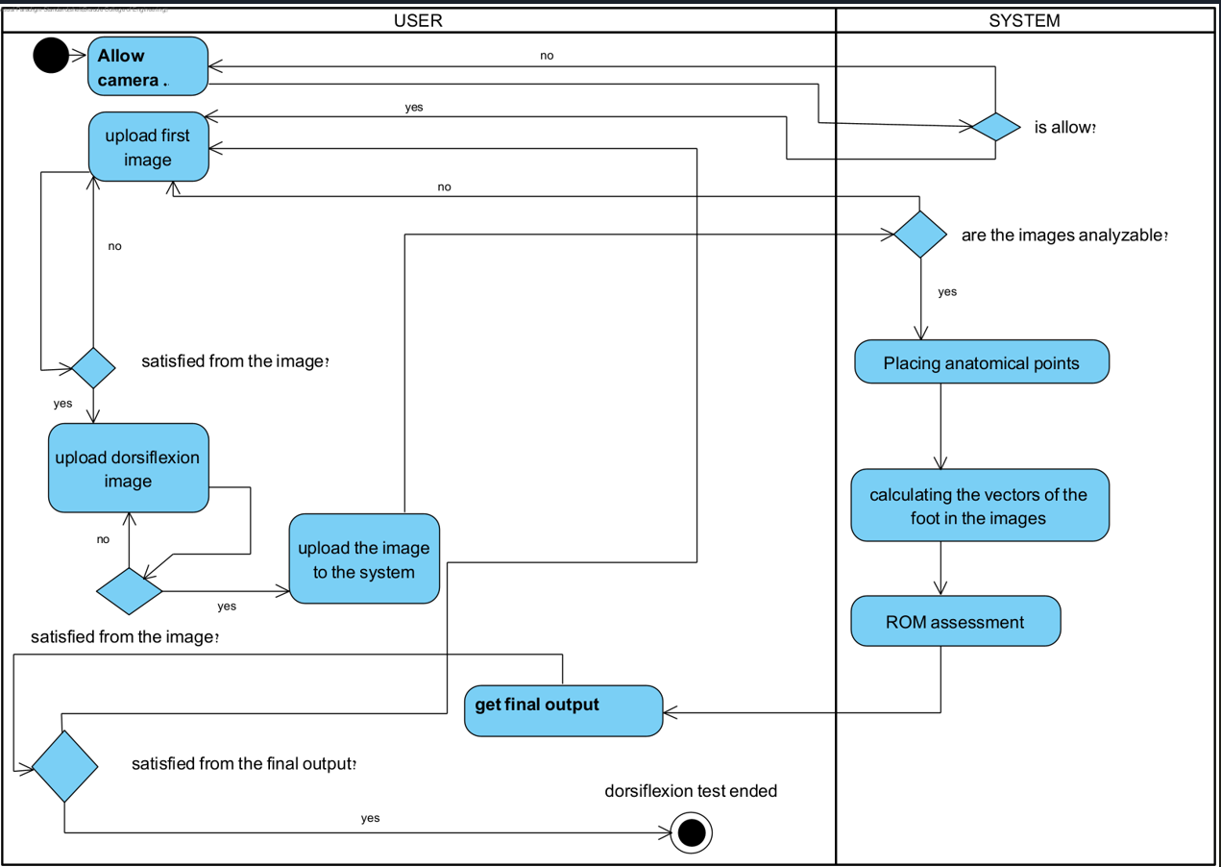
Activity Diagram
.

Slide 14
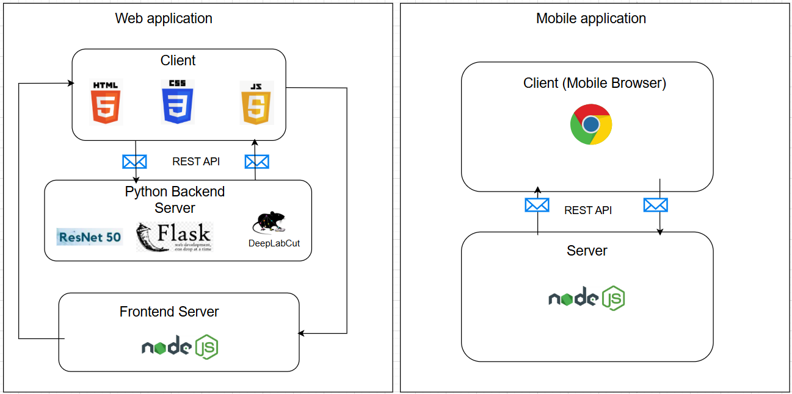
Architecture Diagram
.

Slide 15
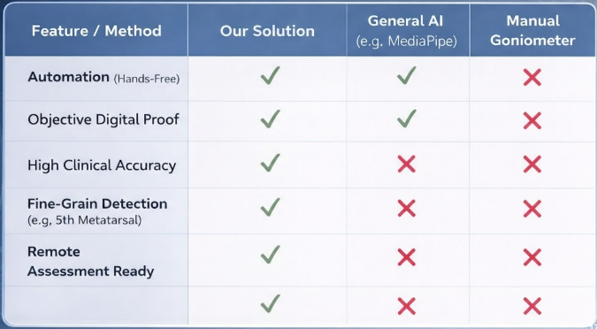
.

Slide 16
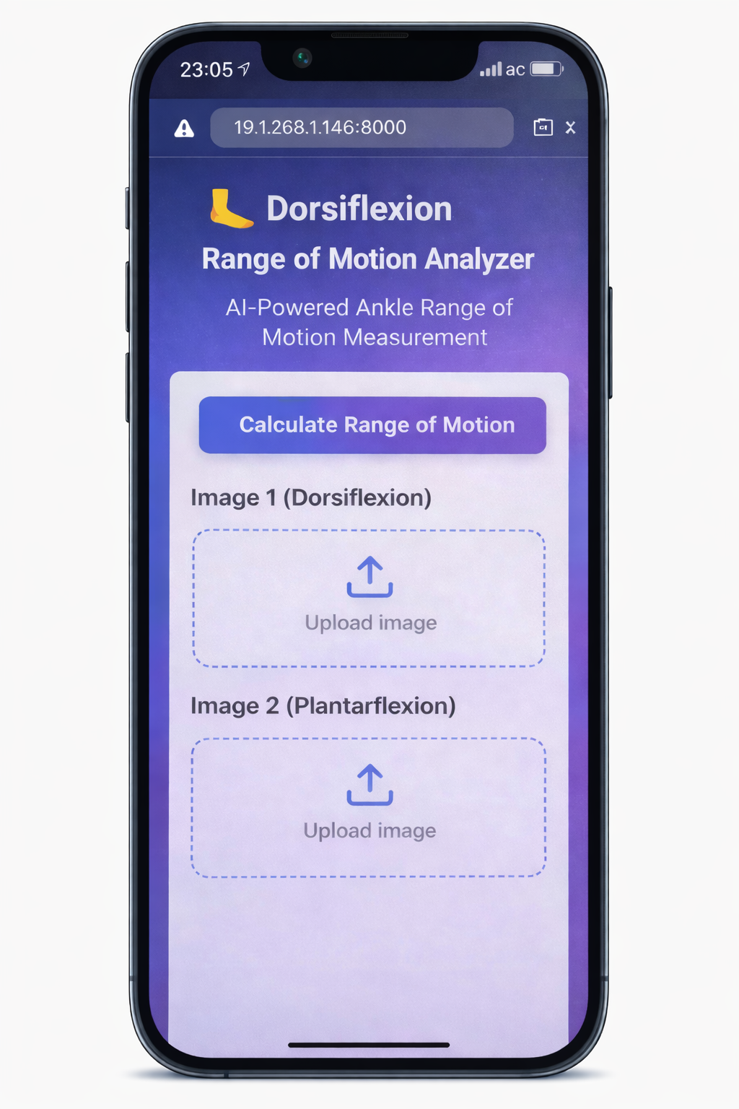
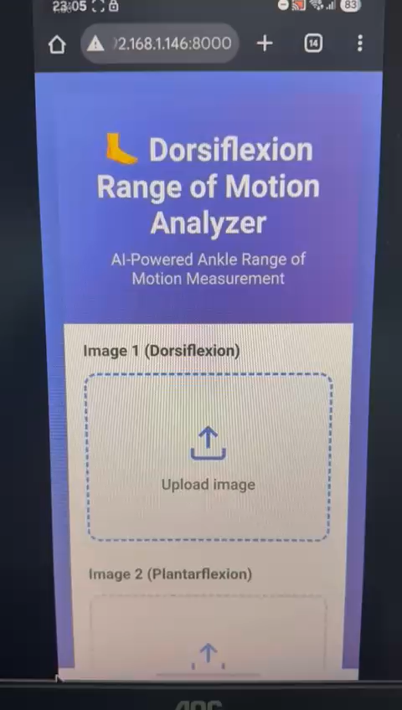
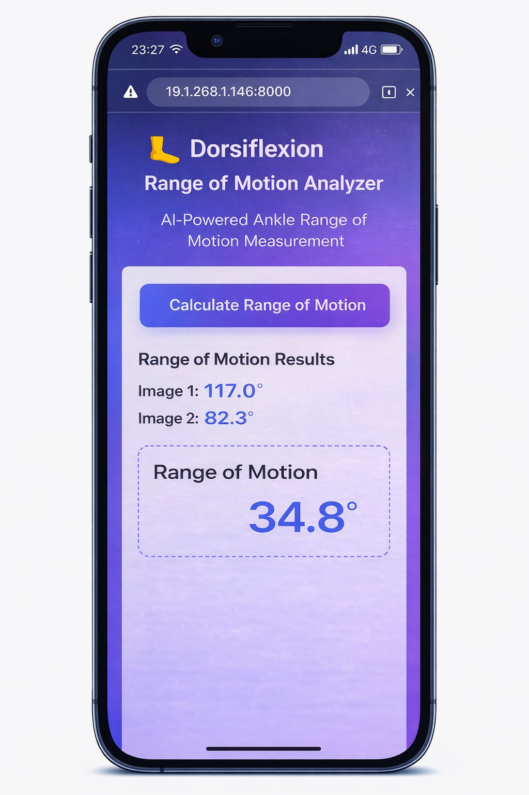
Prototype developed in summer 2025
.

Slide 17
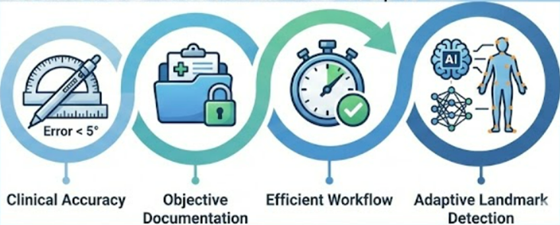
Expected Achievements
Clinical Accuracy – Standardized measurements with an error of up to 5°.
Objective Documentation – Reliable records for clinical and legal use.
Efficient Workflow – Reduced assessment time in busy clinical settings.
Adaptive Landmark Detection – AI-based identification that handles patient variability.
.

Slide 18
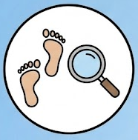



Challenges of our system
.
Anatomical Variability – Accuracy across different foot structures.
Environmental Robustness – Stable performance under varying conditions.
Clinical Precision – Measurement error 5° ≤
Data Quality – Well-annotated clinical images.

Slide 19
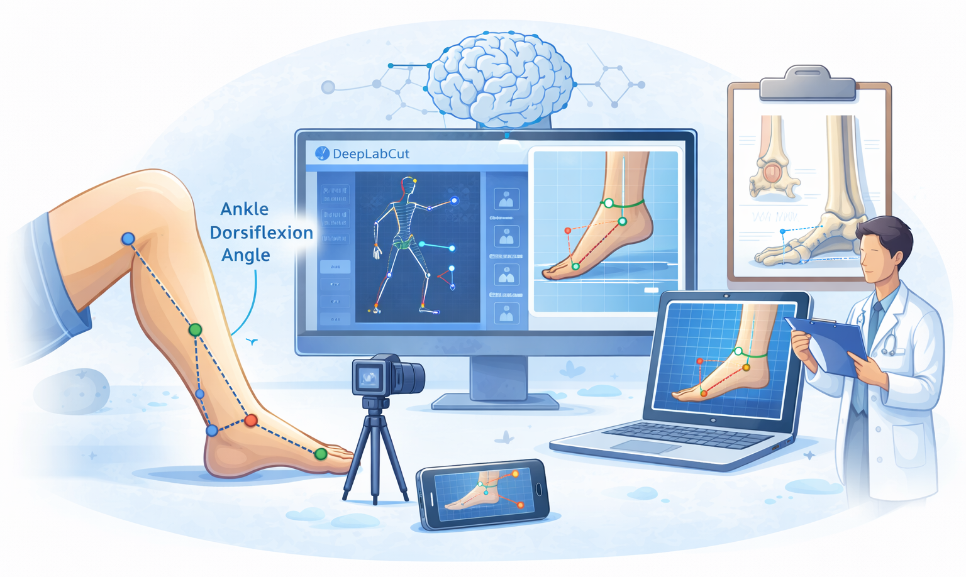
Thank You
Questions ?

